Slide 1
Leveraging CHAMPS Infrastructure to Address the Role of Malaria in Adult Mortality
Presentation by:
Ima-Abasi Bassey
Lead Pathologist, CHAMPS Sierra Leone

Slide 2
Outline:
Background & what we know
Impetus for the adult malaria study
Laboratory findings: Limitations & Pitfalls
The value of the DeCoDe process in attribution of COD
Lessons learned from CHAMPS data

Slide 3
MALARIA
What is known
Globally in 2022
249 million malaria cases
608 000 malaria deaths in 85 countries.
The African Region was home to 94% of malaria cases and 95% of malaria deaths.
Children under 5 accounted for about 80% of all malaria deaths in the Region. (WHO World malaria report 2023).
Karachi, Pakistan
Baliakandi,
Bangladesh
Bamako, Mali
Harar/Kersa, Ethiopia
Makeni, Sierra Leone
Bauchi and Calabar, Nigeria
Kisumu, Kenya
Quelimane, Mozambique
Manhiça, Mozambique
Soweto, South Africa

Slide 4
What is known
Adult mortality rates in endemic areas are generally lower compared to children because many adults in malaria-endemic areas develop partial immunity over time due to repeated exposure to the malaria parasite
.

Slide 5
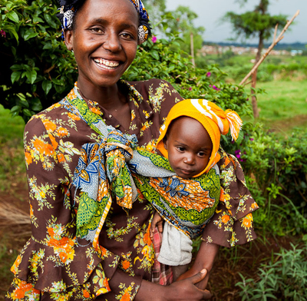

What was new as suggested by a recent study?
Carshon-Marsh R, Aimone A, Ansumana R, Swaray IB, Assalif A, Musa A, Meh C, Smart F, Hang Fu S, Newcombe L, Kamadod R, Saikia N, Gelband H, Jambai A, Jha P. Child, maternal, and adult mortality in Sierra Leone: nationally representative mortality survey 2018-20. Lancet Glob Health. 2022 Jan;10(1):e114-e123. doi: 10.1016/S2214-109X(21)00459-9. Epub 2021 Nov 25. PMID: 34838202; PMCID: PMC8672062.

Slide 6
In 2022
A study by Carshon-Marsh et al. - Lancet Glob Health
A physician review of verbal apsies (VA) collected as a part of a nationally-representative survey in Sierra Leone estimated deaths due to malaria:
20% of deaths among 15-29 years
14% among 30-69 years
The Big Question??
Could Malaria Indeed be a Common Cause of Adult Mortality?
If Yes: This had significant public health challenges and broader socio-economic implications affecting families, healthcare systems, and national economies.

Slide 7
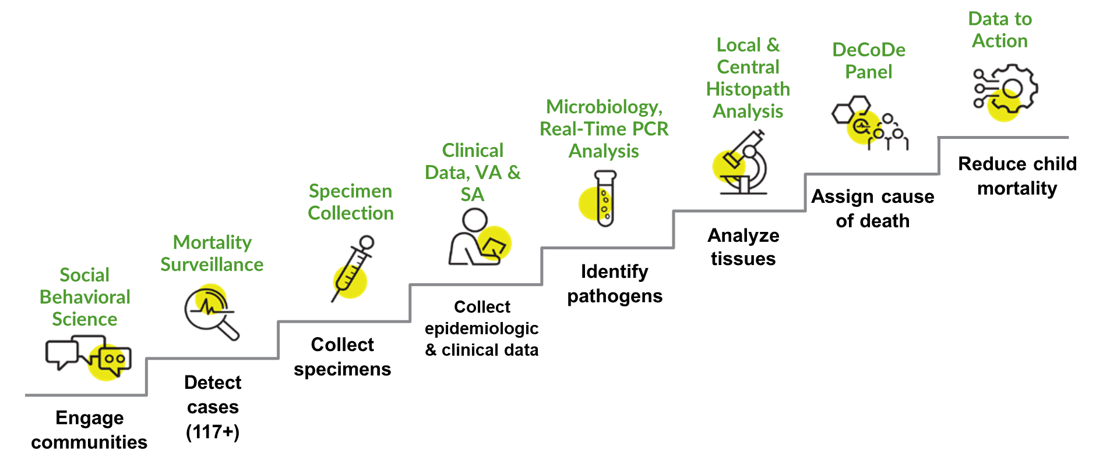
The CHAMPS Advantage
Though primarily about ‘Child Health’, CHAMPS was uniquely positioned to take on this scientific question
Sensitivity and specificity of verbal autopsy alone for malaria COD are not perfect.
CHAMPS methodology is more robust:
Improves the evidence for assigning causes of death for adult in high malaria transmission areas.
Includes data from clinical abstractions, verbal & social autopsy records, laboratory investigations (including gross examination, microbiology/molecular testing, and histopathology investigations)

Slide 8
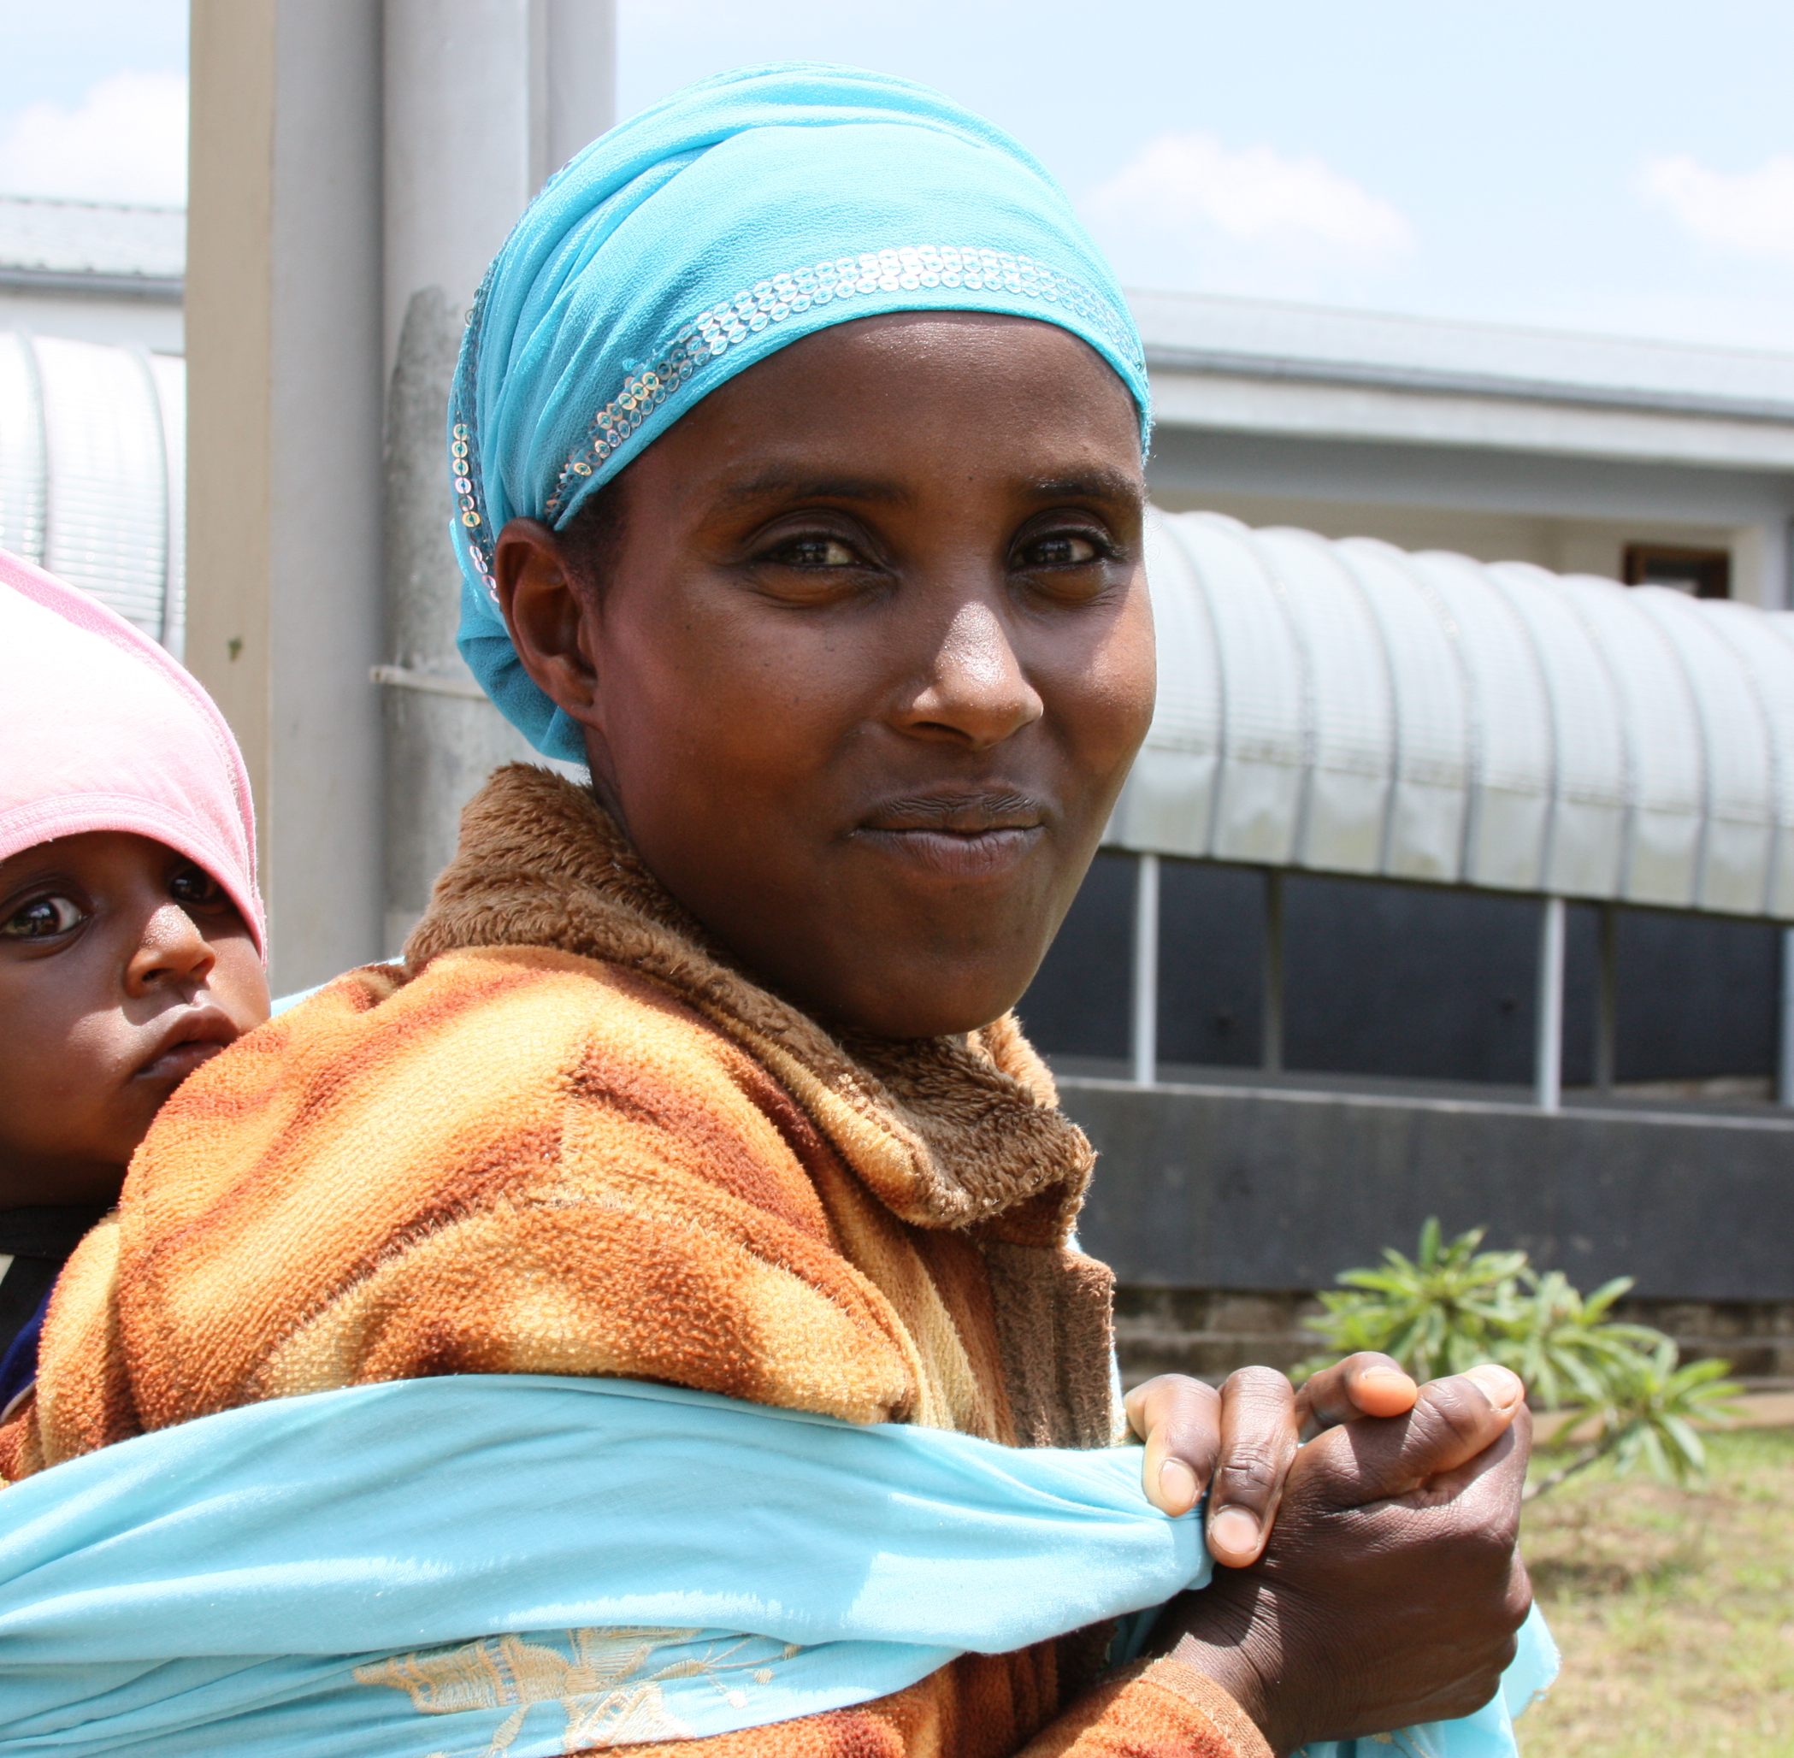
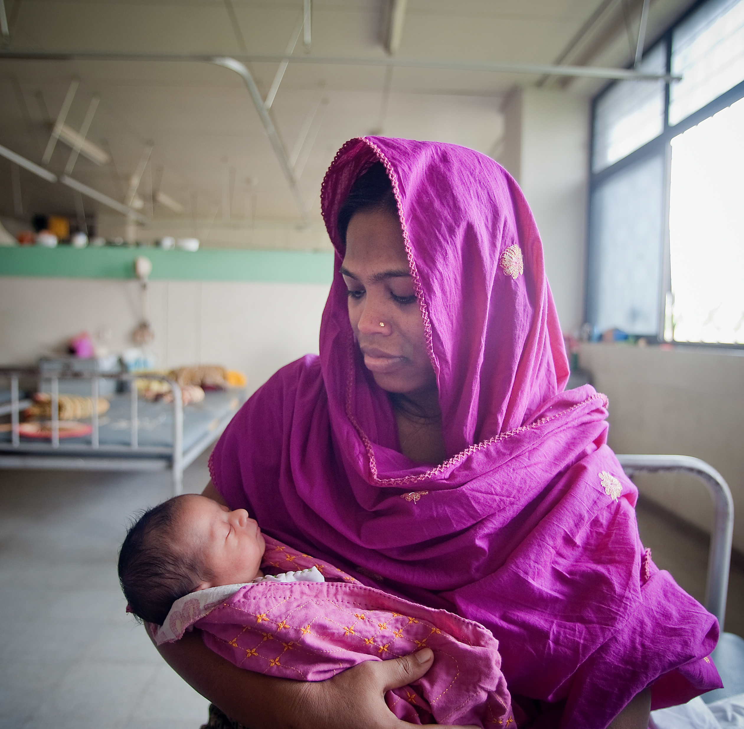
July 2022:
Pivoting to Investigate Adult Mortality
Data from Sierra Leone & Kenya CHAMPS Sites

Slide 9
Adult Malaria Study in Sierra Leone & Kenya
Using CHAMPS protocols, between July 2022 and December 2023 CHAMPS network prospectively enrolled 624 adult deaths from 2 site with the highest mortality from malaria based on child cases.
  324 cases from Kenya
  300 cases from Sierra Leone
Cases underwent a standardized minimally invasive tissue sampling (MITS) procedure to collect tissue from liver, lungs, and brain. Peripheral blood, cerebrospinal fluid (CSF), stool, and oropharyngeal/ nasopharyngeal (OP/NP) swabs were also taken. These were all tested.

Slide 10
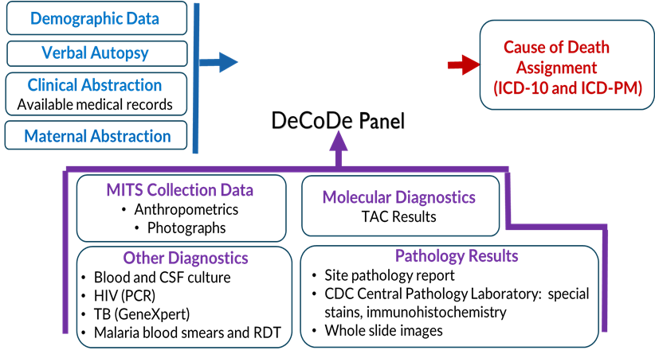
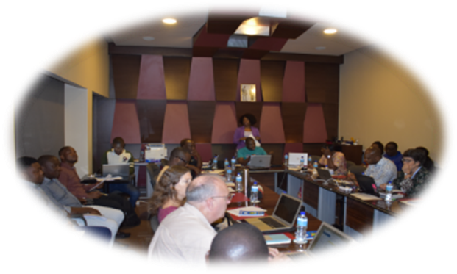
Investigating the claims
The aim of this study was to
Differentiate adults ‘dying from’ malaria versus adults ‘dying with’ malaria through a standardized approach
This involved:
Postmortem Minimally Invasive Tissue Sampling (MITS)
Expert panel review of data

Slide 11

Characteristics of Study Population Enrolled at Both CHAMPS Sites (Kenya & Sierra Leone)

Slide 12
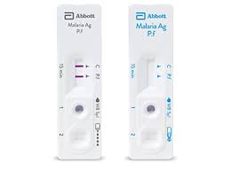
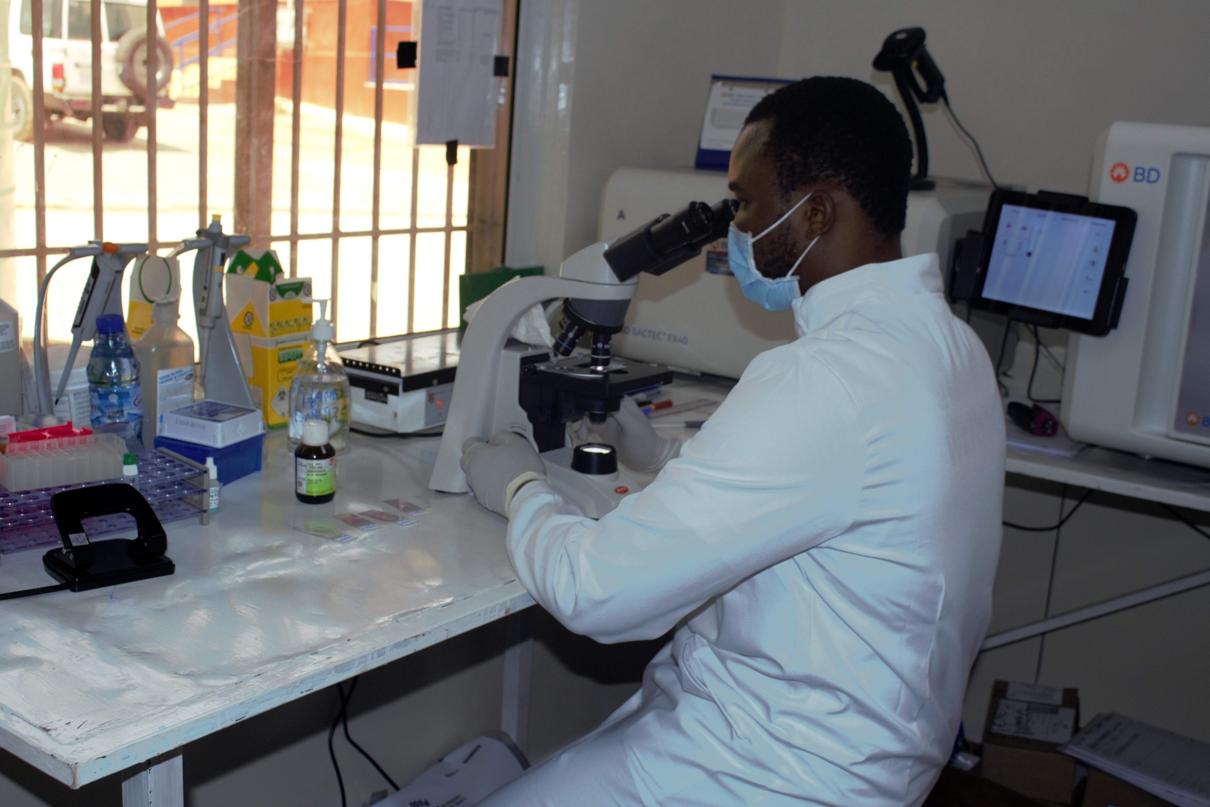
Interpreting malaria positivity:
The Considerations
Blood Film Microscopy
Often considered the "gold standard" for malaria diagnosis.
Drawback: false negatives - a low blood parasite count on a peripheral blood smear does not necessarily correlate with the severity of the disease.
Rapid Diagnostic Tests (RDTs)
Most commonly used tests within the study facilities
highly sensitive and specific tests especially valuable for detecting Plasmodium falciparum.
Drawback: False negatives

Slide 13
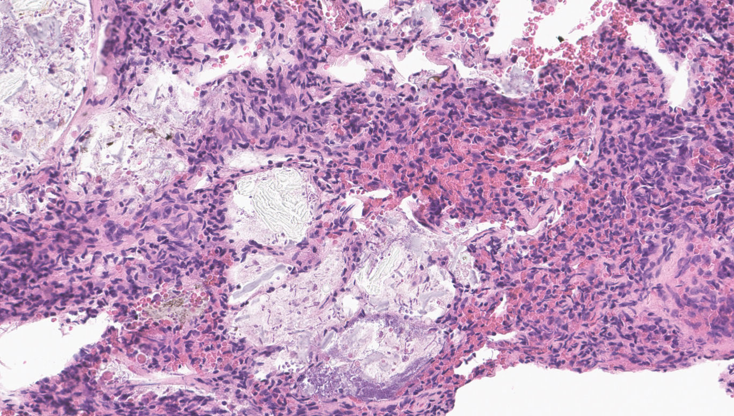
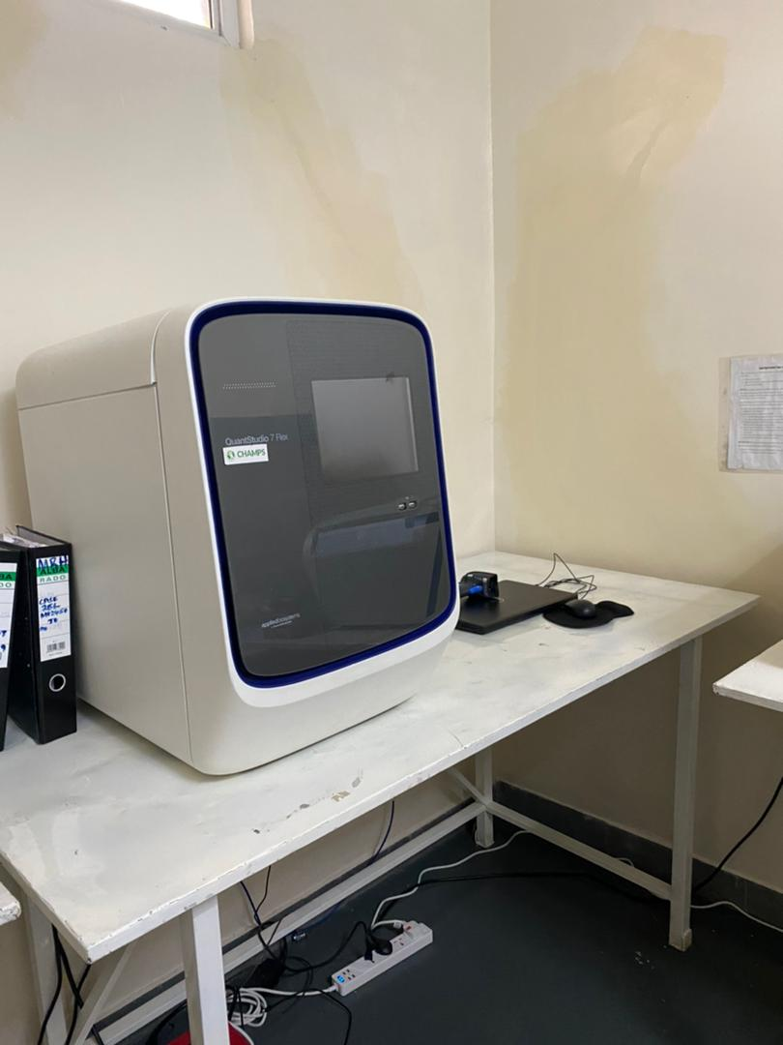
Interpreting malaria positivity:
The Considerations
PCR
Exceptional sensitivity, specificity and ability to detect low levels of parasitemia
A positive PCR result does not necessarily indicate an active infection
Drawback: detects parasite DNA, which can persist for some time after the parasites have been cleared by treatment
Histopathology
Can generally show the extent of tissue damage and can confirm malaria as the cause of death.
Drawback: Not used as a primary diagnostic tool in routine malaria management

Slide 14
Cause of Death Attribution
Determining whether adults were dying from malaria or dying with malaria necessitates a more intricate assessment, which includes:
laboratory tests that evaluate organ function and complications,
exclusion of other causes,
careful consideration of the individual’s risk factors, and epidemiological context.
The CHAMPS study convened an external panel of experts to design a ‘malaria cause of death algorithm’ for that purpose. (i.e. criteria to attribute ‘Cause of Death’ in adults)

Slide 15
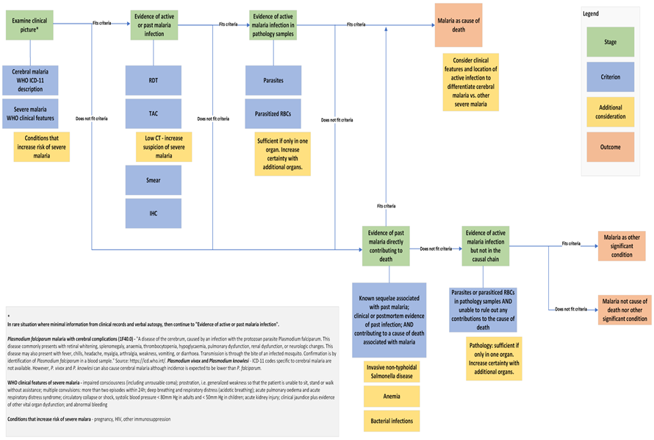

Malaria cause of death algorithm

Slide 16
The Verdict
Proportion of malaria positive cases
Proportion of cases with malaria in the causal chain
Notes:
Only 3 cases had malaria in causal chain

Slide 17
Using the ‘malaria cause of death algorithm’, let’s examine the ways the positivity played out…..

Slide 18
Demographic, Clinical and Laboratory Characteristics of Malaria Deaths (*Severity = Coma, Acute Renal Failure, Shock, Dyspnea, Bleeding Disorder; Mortality Risk Factors = anemia, pregnancy, co-existing chronic disease, cancer & other immunosuppressive diseases)
Case | Age (Yrs) | Sex | Place of death | Malaria Season | HIV | Mortality Risk Factors | Severity | RDT | PCR | Blood Smear | Path
1 KE | 18-29 | M | Community | Off-peak | - | - | - | + | + | + | +
2 KE | 18-29 | F | Facility | Off-peak | HIV | Yes | Yes | - | + | - | +
3 KE | 30-44 | F | Community | Off-peak | HIV | Yes | Yes | + | + | + | +
4 KE | 30-44 | F | Facility | Peak | HIV | Yes | Yes | + | + | + | -
5 SL | 30-44 | M | Facility | Peak | HIV | Yes | Yes | + | - | - | +
6 SL | 30-44 | F | Facility | Off-peak | HIV | Yes | Yes | + | + | + | +
7 SL | 30-44 | F | Community | Off-peak | - | Yes | Yes | + | + | - | +
8 KE | 45-59 | M | Community | Peak | - | Yes | Yes | + | + | + | -
9 KE | 70+ | F | Facility | Off-peak | - | Yes | Yes | + | + | - | +
10 KE | 70+ | F | Community | Off-peak | - | Yes | Yes | + | + | - | -

Slide 19
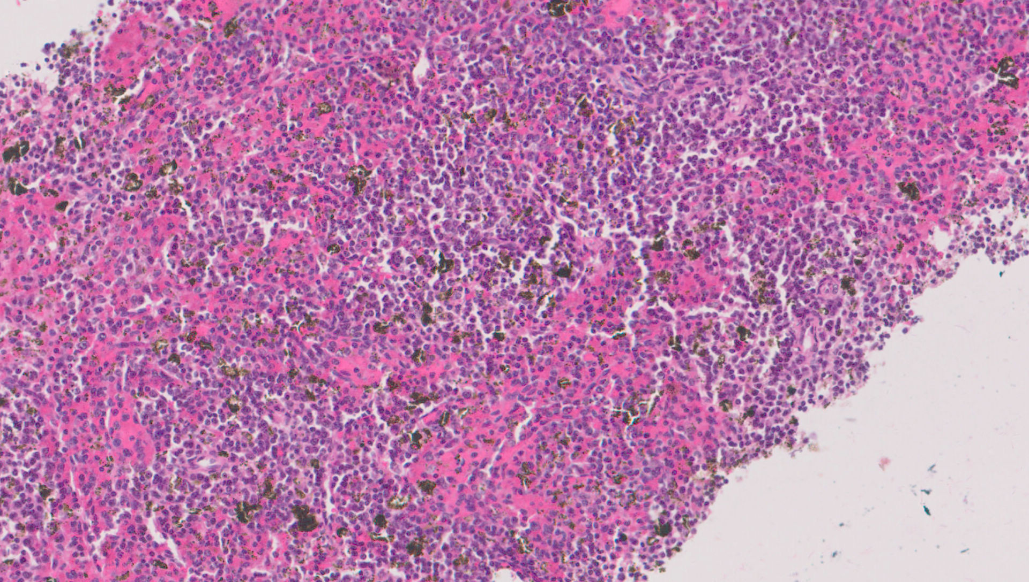
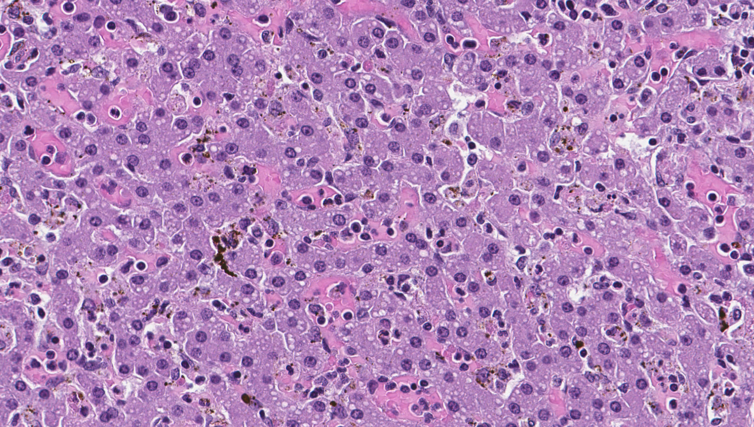
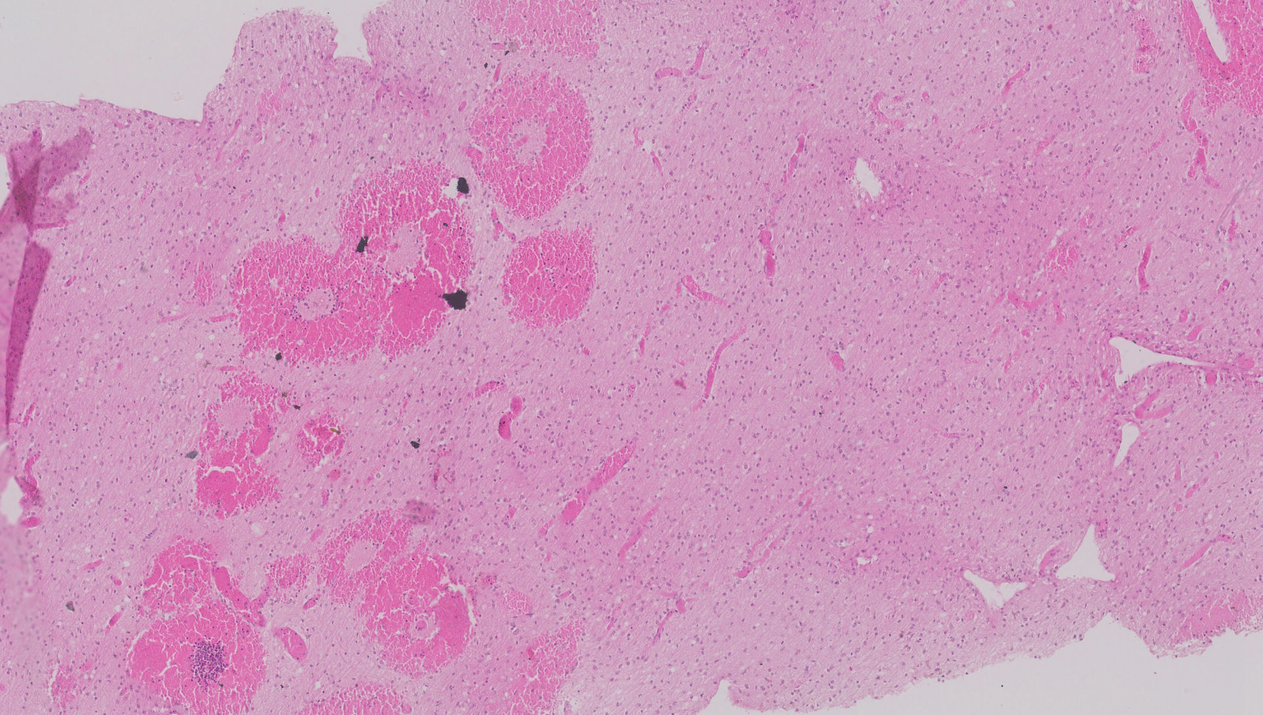
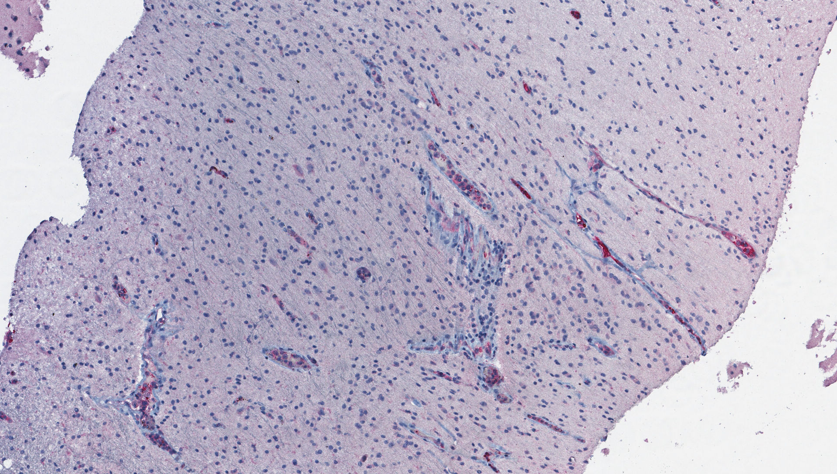
Organ Pathology in Malaria
Spleen
Liver
Brain
Brain (IHC)

Slide 20
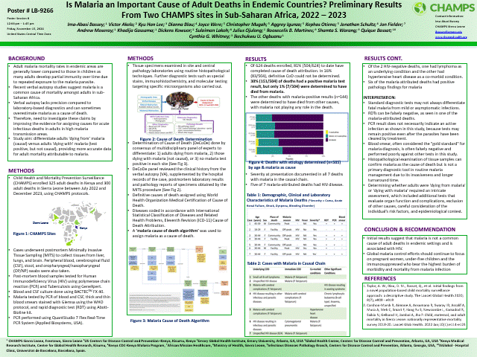
For More on the Findings of the CHAMPS Malaria Study:
Visit the poster presentation stand today:
Venue: Middle Terrace
Time: 5:00pm - 6:15pm

Slide 21
Finally:
A quick comparison
Child Data Vs Adult Data (SL):
What did we learn?

Slide 22
Enrollment Data (Child MITS & Adult MITS)

Slide 23
Enrollment Data (Child MITS & Adult MITS)

Slide 24
Proportion of malaria positive cases found to be in the causal chain

Slide 25
Overall Mortality From Malaria

Slide 26
Summary & Conclusion
Our study was able to cement the fact that Malaria as a COD in adults is not as common as suggested by the VA study but does occur within the context of risk factors (HIV, cancer & other immunosuppressive diseases, co-existing chronic disease, age e.t.c.)​
Assigning a malaria COD in adults is a multipronged approach
The algorithm that CHAMPS has developed, would be a good resource for future cause of death attribution
Plans are in place for verbal autopsy physician coding to do an internal comparison of the CHAMPS cases

Slide 27
Conclusion contd.
Our study demonstrates how CHAMPS sites are built to be able to pivot quickly, taking advantage of existing infrastructure (equipment, skilled manpower) to take on studies to answer challenging questions in challenging contexts within a short timeframe.​
Future possibilities using the CHAMPS platform: With introduction of the malaria vaccine in Sierra Leone and Kenya, it could be possible to assess the impact of the vaccine over the coming months and years.

Slide 28


Thank You!
To learn more about CHAMPS contact us at info@champshealth.org
www.champshealth.org

